Slide 1


ROBOT ARM INSTRUCTION
PART.4 – MECHANICAL CHARACTERISTICS
Prof. Wooyong Kim
Assistant. Dongsik Park
Department of Biomedical & Robotics Engineering,
Incheon National University
Summer, 2026

Slide 2
Table of Contents
  Planetary Gear
  Forward Kinematics
  Inverse Kinematics

Slide 3
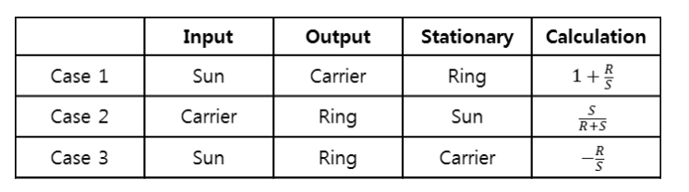
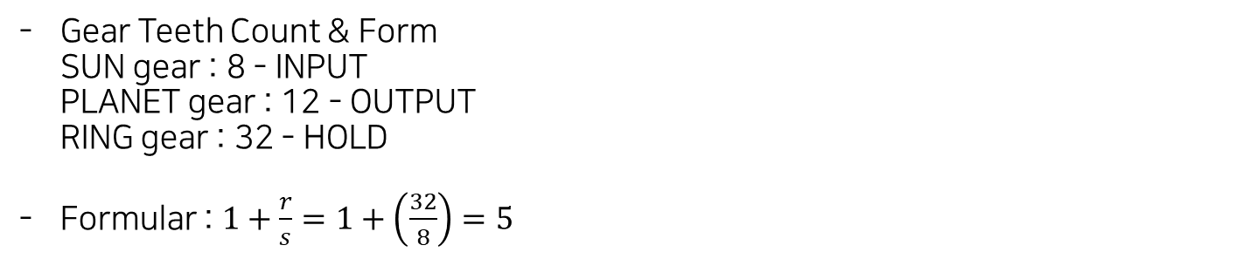
1. Planetary Gear
Specific & Caculation
Gear Teeth Count & Form
SUN gear : 8 - INPUT
PLANET gear : 12 - OUTPUT
RING gear : 32 - HOLD
Formular : $1+\frac{r}{s}=1+\left(\frac{32}{8}\right)=5$

Slide 4
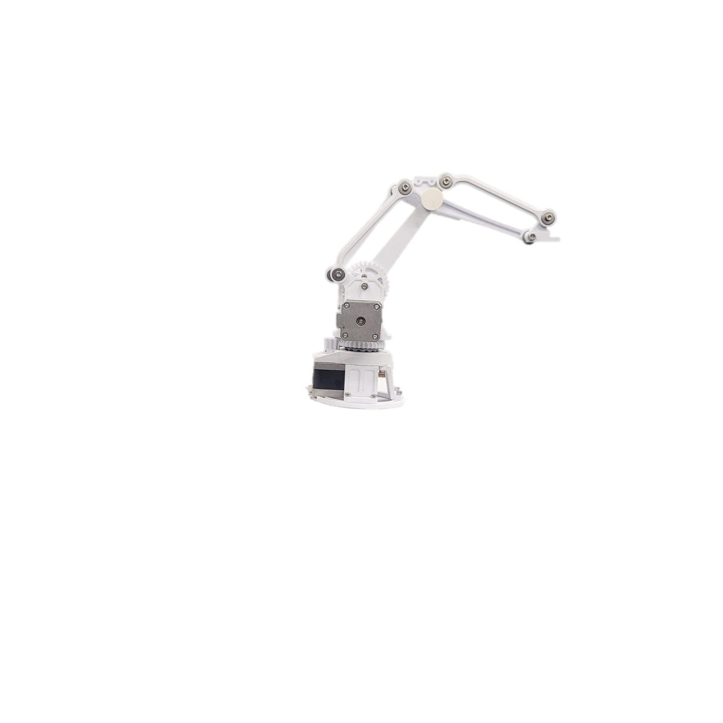



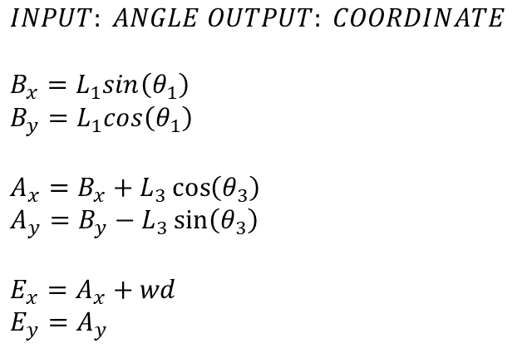





2. Forward Kinematics
$$INPUT: ANGLE OUTPUT: COORDINATE$$
$$B_{x}=L_{1}sin\left(θ_{1}\right)$$
$$B_{y}=L_{1}cos\left(θ_{1}\right)$$
$$A_{x}=B_{x}+L_{3}\cos\left(θ_{3}\right)$$
$$A_{y}=B_{y}−L_{3}\sin\left(θ_{3}\right)$$
$$E_{x}=A_{x}+wd$$
$$E_{y}=A_{y}$$
$$θ_{3}$$
$$B_{x},B_{y}$$
$$wd$$
$$L_{3}$$
$$L_{1}$$
$$A_{x},A_{y}$$
$$E_{x},E_{y}$$
$$θ_{1}$$
We convert angles to align with different reference points: in math, angles are counterclockwise from the x-axis, but in this robotic arm, angles like theta 1 and theta 3 are measured clockwise from specific lines.

Slide 5


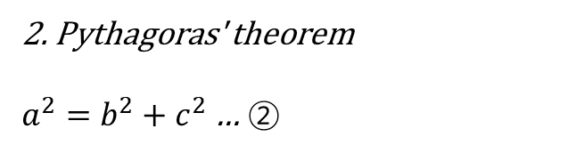

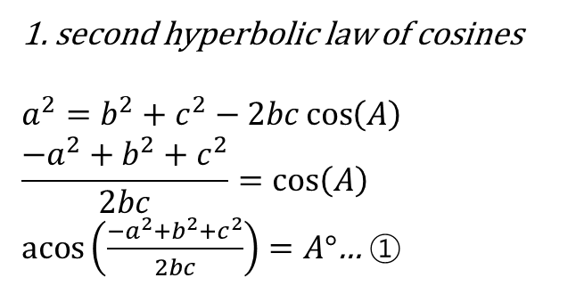




3. Inverse Kinematics
$$A$$
1. second hyperbolic law of cosines
$$a^{2}=b^{2}+c^{2}−2bc\cos\left(A\right)$$
$$\frac{{−a}^{2}+b^{2}+c^{2}}{2bc}=\cos\left(A\right)$$
$\operatorname{acos}\left(\frac{{−a}^{2}+b^{2}+c^{2}}{2bc}\right)=A°$… ①
$$c$$
$$b$$
$$a$$
2. Pythagoras' theorem
$a^{2}=b^{2}+c^{2}$ … ②
$$c$$
$$a$$
$$b$$

Slide 6














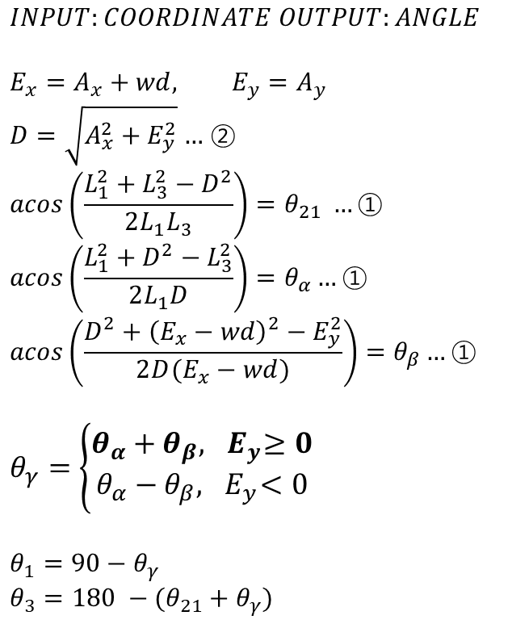

3. Inverse Kinematics
$$INPUT:COORDINATE OUTPUT:ANGLE$$
$$E_{x}=A_{x}+wd, E_{y}=A_{y}$$
$D=\sqrt{A_{x}^{2}+E_{y}^{2}}$ … ②
$$\operatorname{acos}\left(\frac{L_{1}^{2}+L_{3}^{2}−D^{2}}{2L_{1}L_{3}}\right)=θ_{21} …\text{①}$$
$$\operatorname{acos}\left(\frac{L_{1}^{2}+D^{2}−L_{3}^{2}}{2L_{1}D}\right)=θ_{α}…\text{①}$$
$$\operatorname{acos}\left(\frac{D^{2}+{\left(E_{x}−wd\right)}^{2}−E_{y}^{2}}{2D(E_{x}−wd)}\right)=θ_{β}…\text{①}$$
$$θ_{γ}=\left\{\begin{aligned}θ_{α}+θ_{β}, { E}_{y}≥0 \\ &θ_{α}−θ_{β},{ E}_{y}<0\end{aligned}\right.$$
$$θ_{1}=90−θ_{γ}$$
$$θ_{3}=180 −(θ_{21}+θ_{γ})$$
$$B_{x},B_{y}$$
$$θ_{γ}$$
$$θ_{3}$$
$$θ_{21}$$
$$L_{3}$$
$$wd$$
$$L_{1}$$
$$A_{x},A_{y}$$
$$E_{x},E_{y}$$
$$θ_{1}$$
$$θ_{γ}$$
$$D$$
$$θ_{3}$$
$$θ_{α}$$
$$θ_{β}$$

Slide 7
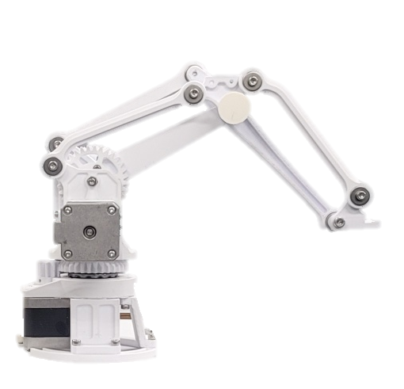









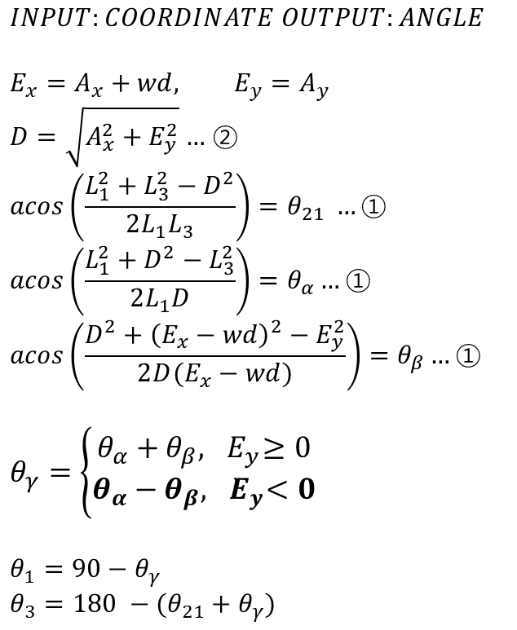

3. Inverse Kinematics
$$INPUT:COORDINATE OUTPUT:ANGLE$$
$$E_{x}=A_{x}+wd, E_{y}=A_{y}$$
$D=\sqrt{A_{x}^{2}+E_{y}^{2}}$ … ②
$$\operatorname{acos}\left(\frac{L_{1}^{2}+L_{3}^{2}−D^{2}}{2L_{1}L_{3}}\right)=θ_{21} …\text{①}$$
$$\operatorname{acos}\left(\frac{L_{1}^{2}+D^{2}−L_{3}^{2}}{2L_{1}D}\right)=θ_{α}…\text{①}$$
$$\operatorname{acos}\left(\frac{D^{2}+{\left(E_{x}−wd\right)}^{2}−E_{y}^{2}}{2D(E_{x}−wd)}\right)=θ_{β}…\text{①}$$
$$θ_{γ}=\left\{\begin{aligned}θ_{α}+θ_{β}, { E}_{y}≥0 \\ &θ_{α}−θ_{β},{ E}_{y}<0\end{aligned}\right.$$
$$θ_{1}=90−θ_{γ}$$
$$θ_{3}=180 −(θ_{21}+θ_{γ})$$
$$B_{x},B_{y}$$
$$θ_{γ}$$
$$θ_{3}$$
$$θ_{1}$$
$$θ_{21}$$
$$θ_{3}$$
$$L_{1}$$
$$L_{3}$$
$$θ_{α}$$
$$θ_{γ}$$
$$θ_{β}$$
$$D$$
$$wd$$
$$A_{x},A_{y}$$
$$E_{x},E_{y}$$

Slide 8
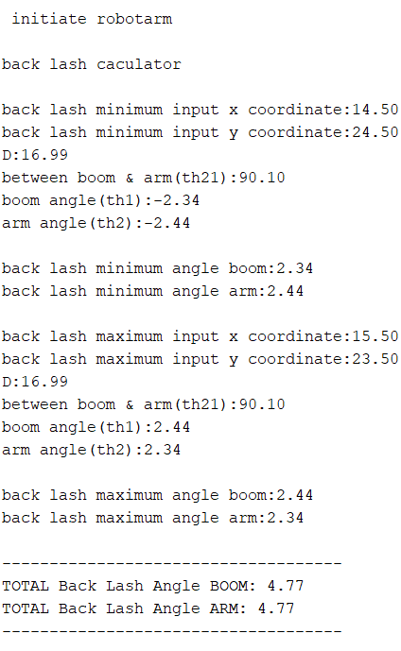







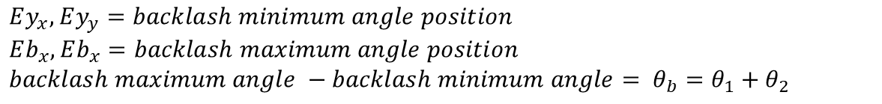
4. Backlash caculate
$${Eb}_{x},{Eb}_{y}$$
$${Ey}_{x},{Ey}_{y}$$
$$D_{b}$$
$$θ_{2}$$
$$θ_{1}$$
$$D_{y}$$
$$θ_{b}$$
$$Ey_{x},Ey_{y}=backlash minimum angle position$$
$$Eb_{x},Eb_{x}=backlash maximum angle position$$
$$backlash maximum angle −backlash minimum angle= θ_{b}=θ_{1}+θ_{2}$$

Slide 9
Thanks.

